Slide 1
Electronic Communication
Lecture 5 – COMPSCI111/111G

Slide 2
Today’s lecture
Looking at how different types of electronic communication work
Email
Instant messaging
Forums
Issues with electronic communication
Spam
Netiquette
Security issues
Authenticating users

Slide 3
Email
Electronic Mail; a system for sending and receiving messages over the Internet
An asynchronous means of communication
Necessary to know the address of the recipient in order to send an email message

Slide 4
Email - history
1960s: initially, people would leave messages for each other on a mainframe
However, there was no way to send messages to people using other mainframes
1969: ARPANET connected mainframes together, providing the foundation for email
1972: Ray Tomlinson sends the first email, with addresses using the @ symbol
1976: email makes up 75% of ARPANET’s traffic

Slide 5
Email - addresses
damir.azhar@auckland.ac.nz
Local part of the address, often a username
Domain name of the email server

Slide 6
Email – composing
Sender
Recipient
Carbon Copy (CC)
Headers
Blind carbon copy (BCC)
Subject
Message body

Slide 7
Email - protocols
Protocol: a standard for communicating
These email protocols are used by email clients (eg. Outlook, Apple Mail) to send and receive email
Webmail services such as Gmail and Hotmail use the same protocols
We will discuss three protocols today:
One for sending emails – SMTP
Two for receiving emails – POP3 and IMAP

Slide 8
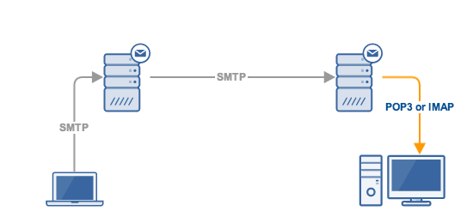
Email - protocols
SMTP - Simple Mail Transfer Protocol:
Used to send emails from an email client via the email server
Recipient’s mail server
Sender’s mail server
Server uses DNS to find recipient mail server’s IP address
auckland.ac.nz ⇆ 130.216.159.127

Slide 9
Email - protocols
POP3 – Post Office Protocol v3:
Emails downloaded from the server to the email client. Emails are then deleted from the server
No Internet connection needed to read downloaded messages
Disadvantages:
If messages are deleted in the email client, then they are lost forever
Difficult to access your email from different devices

Slide 10
Email - protocols
IMAP – Internet Message Access Protocol:
Downloads a copy of emails to the email client and keeps emails on the server
Emails can only be read when online, although most email clients can store a copy for offline access
Provides other helpful features such as folders
Designed to allow users to access their emails from multiple devices

Slide 11
Email - privacy
Email is not a very secure means of communication
Can be read in transit
Can be read by the mail server administrator or stolen from the mail server
Email in employment
Generally, employers reserve the right to read your emails on the company’s email system
Making email more secure
Email encryption tools such as PGP
Some email clients have encryption functionality
Keep your account details secure and use 2FA

Slide 12
Email - spam
Unsolicited, bulk email containing promises of money, fame, free prizes etc.
Name comes from the Monty Python Spam sketch
A major problem; in 2010, approx. 80% of emails were spam
Some spam emails contain attachments or links that can infect a computer with malware
Most email providers have spam filters that divert spam emails to the Junk folder

Slide 13
Email - spam
Unsolicited Electronic Messages Act 2007
Aim: reduce the harm caused by spam, require an unsubscribe feature and deter people from sending spam
The Act regulates commercial electronic messages; any message that promotes a good or service
Electronic message is any message sent using a telecommunications service (eg. email, fax, txt)
The Act applies to anyone who lives or does business in NZ

Slide 14
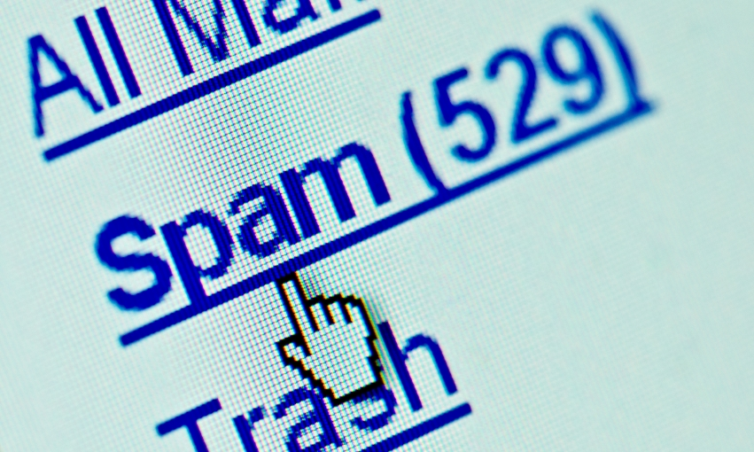
Email - spam
The Act prohibits:
sending an unsolicited commercial electronic message with a NZ link
sending a commercial electronic message without sender information
sending a commercial electronic message without an unsubscribe function
Penalties include:
Fines of up to $200,000
Payment of compensation to people affected by the spam

Slide 15
Inbox Zero
A smart way of managing your email
More productive
Reduces stress

Slide 16
Email ettiquete
Don’t send work related emails outside of normal working hours
After 5pm
At weekends

Slide 17
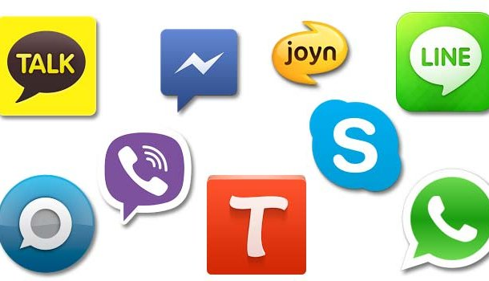
Instant messaging
Instant Messaging (IM) is a way of immediately sending messages over the Internet
A synchronous means of communication
In 2015, there were around 3.2 billion IM accounts. Whatsapp and FB Messenger were the most popular IM apps
Some IM apps offer end-to-end encryption for conversations (eg. Telegram, FB Messenger)

Slide 18
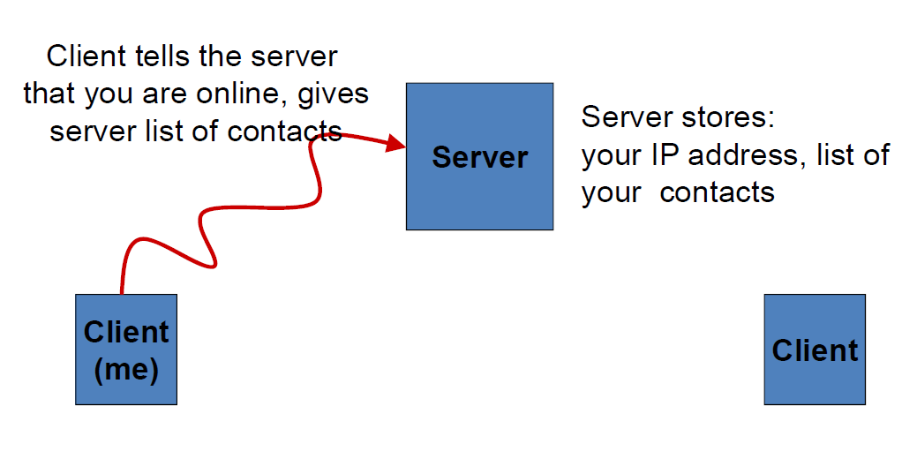
Instant messaging
Sender’s IM client connects to the server

Slide 19
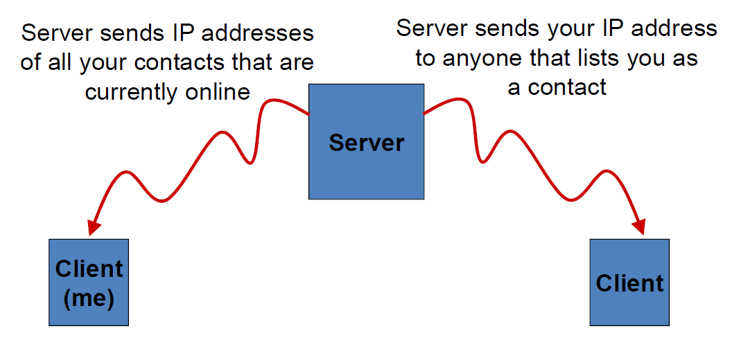
Instant messaging
Server helps clients to exchange IP addresses

Slide 20
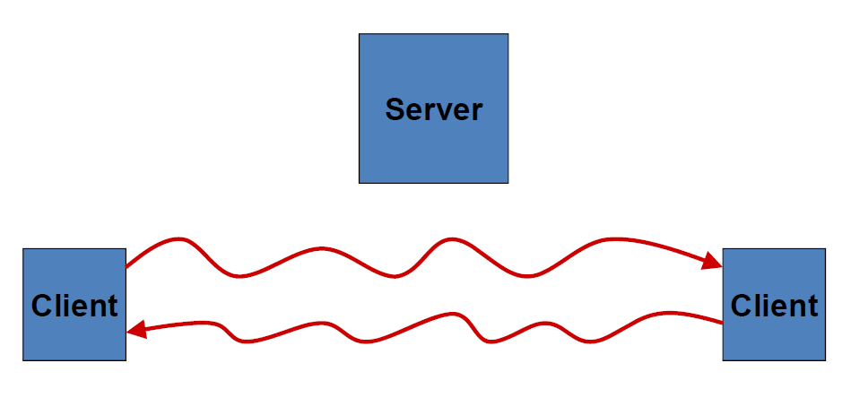
Instant messaging
Once connected, sender and recipient can chat without needing the server

Slide 21
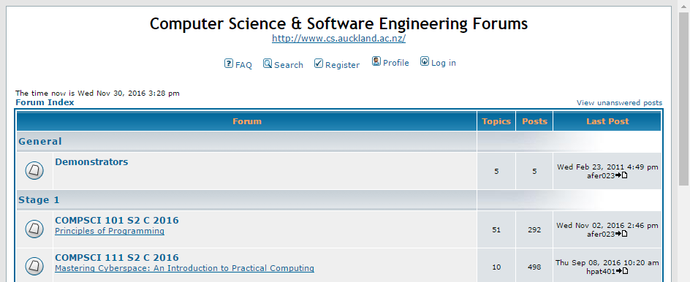
Forums
Forums are an online discussion group about a particular topic
A form of asynchronous communication
Different kinds of forums:
Class forums for courses
Apps have forums where users can help each other (eg. OpenOffice forum)
Forums for discussing different topics (eg. forum on airplanes)

Slide 22
Parts of a forum
Topic (aka thread)
Quote button
Post

Slide 23
Parts of a forum
Moderator: a forum user who can edit, delete or move posts or threads to help keep the forum tidy and organised

Slide 24
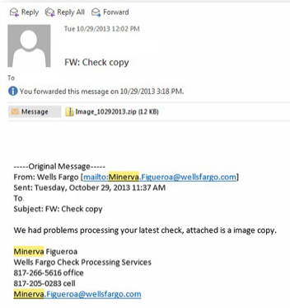
Issues - attachments
An attachment is a file that is included within an email message, IM message or even a forum post
Attachments may contain malicious content so never open an attachment unless you are sure it is from a reliable source
Another precaution is to scan the attachment using an anti-virus program
Attachments have been the main way that Cryptolocker ransomware has spread

Slide 25
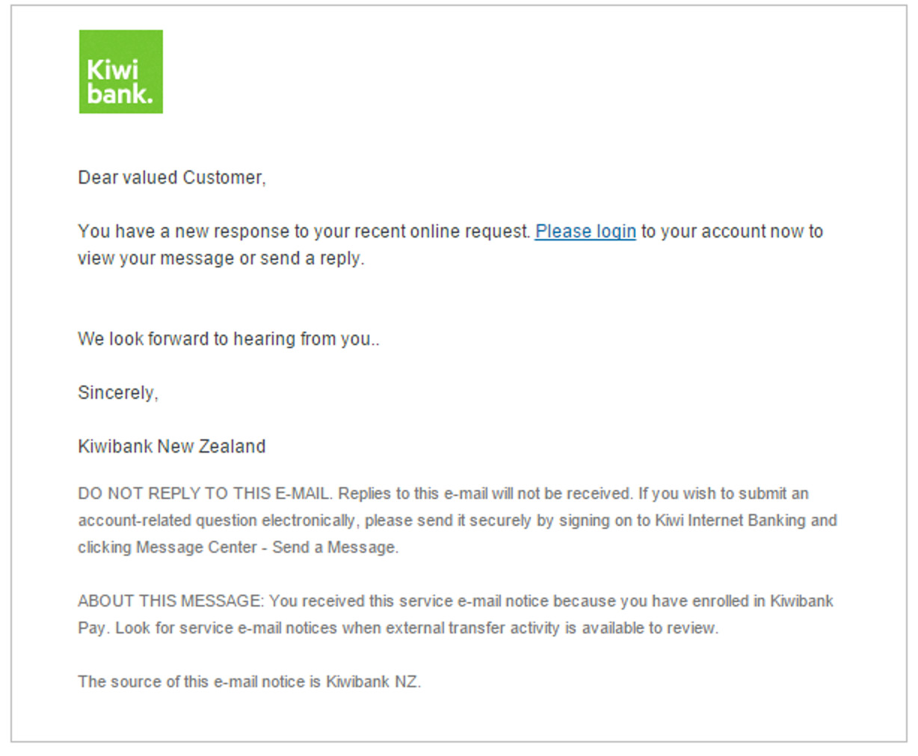
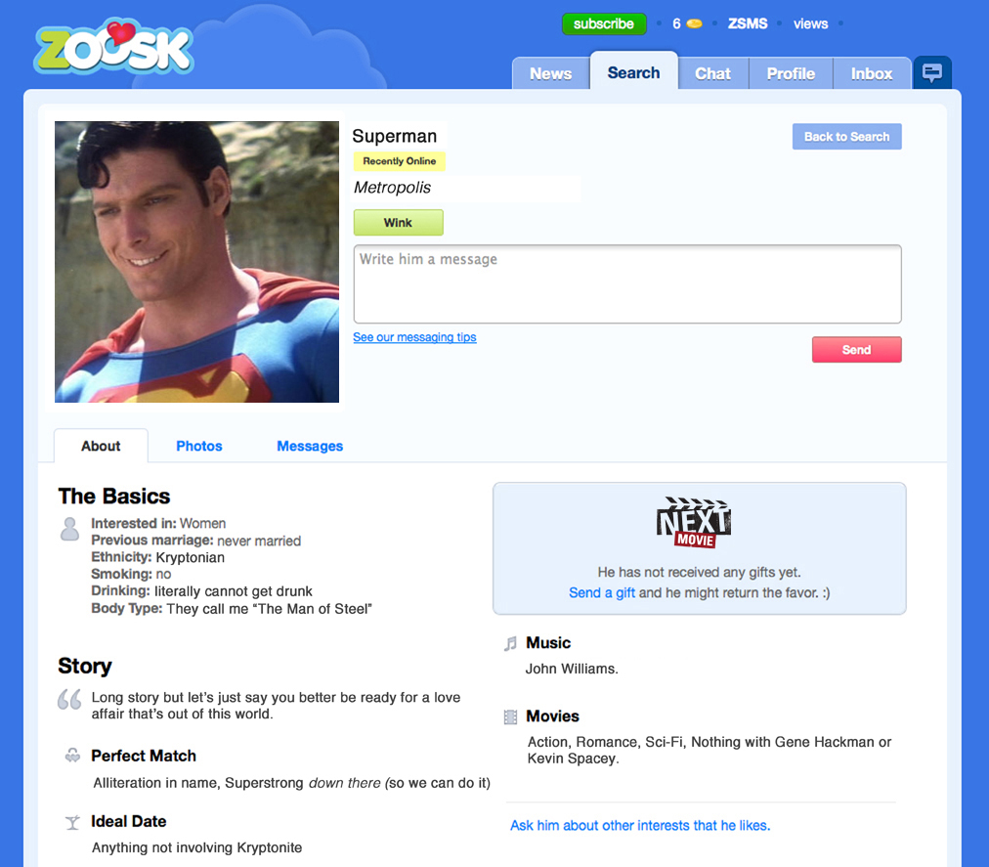
Issues - misrepresentation
People can misrepresent themselves using electronic communication
Phishing emails claiming to be from your bank
False profiles on dating apps and social media
Always worth double-checking a message with the purported sender if you’re suspicious

Slide 26
Issues – Netiquette
Etiquette on the Internet; what is socially acceptable when communicating online
Examples:
Having a greeting and signature in your emails
Not using your cellphone in libraries and quiet spaces
Some reading:
http://www.101emailetiquettetips.com/
http://www.faqs.org/rfcs/rfc1855.html
http://www.albion.com/netiquette/

Slide 27
Exercises
What protocol should I choose on my email client if I want to access my emails using multiple devices?
IMAP
What is the difference between synchronous and asynchronous communications?
Synchronous communications means the recipient receives the message immediately but asynchronous means the recipient gets the message after some time

Slide 28
Exercises
On a forum, what is a reply to a topic or thread called?
Post
What is the domain name in this email address?
customer.help@pizza.co.nz

Slide 29
Answers to Questions
IPv6 has 2³² addresses ~ 4.3 billion
Auckland student email – might be private
Vram and Ram are usually specified separately in computer specifications, but both are volatile
Speed of electromagnetic waves ~ 50%-99% the speed of light

Slide 30
Summary
Email was invented in 1972. Three main protocols: POP3, IMAP, SMTP
IM and forums are other forms of electronic communication
Issues with electronic communication:
Spam
Attachments containing malware
Senders misrepresenting themselves
Securing communications using encryption, protecting account details, 2FA
Netiquette

